Slide 1

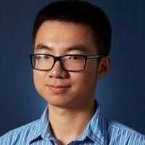
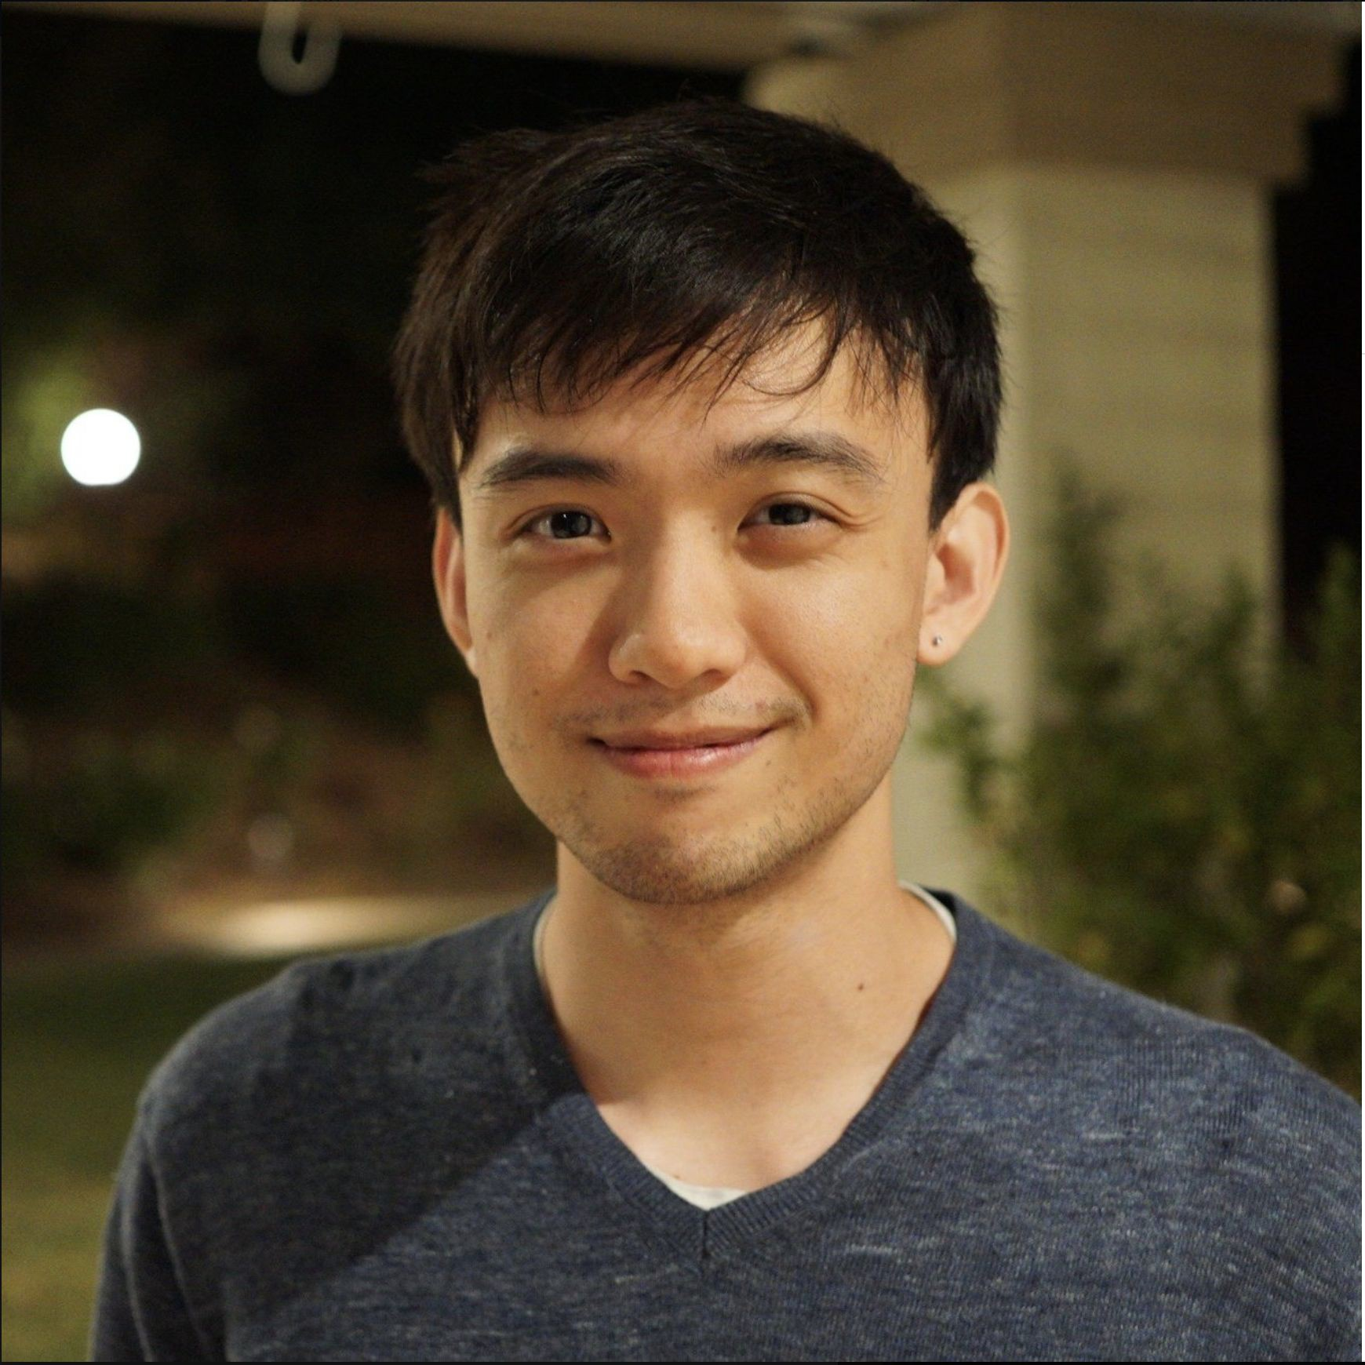
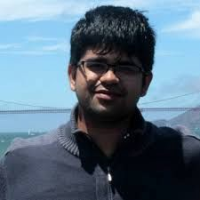
CS294-158 Deep Unsupervised Learning
Lecture 1c: Likelihood Models I: Autoregressive Models
Pieter Abbeel, Peter Chen, Jonathan Ho, Aravind Srinivas UC Berkeley

Slide 2
Likelihood-based models
How do we solve these problems?
Generating data: synthesizing images, videos, speech, text
Compressing data: constructing efficient codes
Anomaly detection
Likelihood-based models: estimate p_{data} from samples x , …, x ~ p (x)
(1) (n)
data
Learns a distribution p that allows:
Computing p(x) for arbitrary x
Sampling x ~ p(x)
Today: discrete data

Slide 3
Desiderata
We want to estimate distributions of complex, high-dimensional data
A 128x128x3 image lies in a ~50,000-dimensional space We also want computational and statistical efficiency
Efficient training and model representation
Expressiveness and generalization
Sampling quality and speed
Compression rate and speed

Slide 4
Estimating frequencies by counting
Recall: the goal is to estimate p from samples x⁽¹⁾, …, x^{(n)} ~ p (x)
data data
Suppose the samples take on values in a finite set {1, …, k} The model: a histogram
(Redundantly) described by k nonnegative numbers: p , …, p
To train this model: count frequencies
1 k
p_{i} = (# times i appears in the dataset) / (# points in the dataset)

Slide 5
At runtime
Inference (querying p_{i} for arbitrary i): simply a lookup into the array p₁, …, p_{k}
Sampling (lookup into the inverse cumulative distribution function)
1. From the model probabilities p , …, p , compute the cumulative
1 k
distribution
F_{i} = p₁ + ⋯ + p_{i} for all i ∈ {1, …, k}
Draw a uniform random number u ~ [0, 1]
Return the smallest i such that u ≤ F
i
Are we done?

Slide 6
Failure in high dimensions
No, because of the curse of dimensionality. Counting fails when there are too many bins.
(Binary) MNIST: 28x28 images, each pixel in {0, 1}
There are 2⁷⁸⁴ ≈ 10²³⁶ probabilities to estimate
Any reasonable training set covers only a tiny fraction of this
Each image influences only one parameter. No generalization whatsoever!
Solution: function approximation. Instead of storing each probability, store a parameterized function p_{θ}(x)

Slide 7
Likelihood-based generative models
Recall: the goal is to estimate p_{data} from x , …, x ~ p (x)
(1) (n)
data
Now we introduce function approximation: learn θ so that p_{θ}(x) ≈ p_{data}(x).
How do we design function approximators to effectively represent complex joint distributions over x, yet remain easy to train?
There will be many choices for model design, each with different tradeoffs and different compatibility criteria.
Designing the model and the training procedure go hand-in-hand.

Slide 8
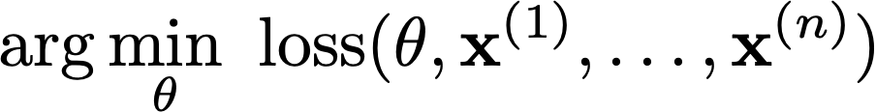
Fitting distributions
- Given data x⁽¹⁾, …, x^{(n)} sampled from a “true” distribution p
data
Set up a model class: a set of parameterized distributions p_{θ}
Pose a search problem over parameters
Want the loss function + search procedure to:
Work with large datasets (n is large, say millions of training examples)
Yield θ such that p_{θ} matches p_{data} — i.e. the training algorithm works. Think of the loss as a distance between distributions.
Note that the training procedure can only see the empirical data distribution, not the true data distribution: we want the model to generalize.

Slide 9
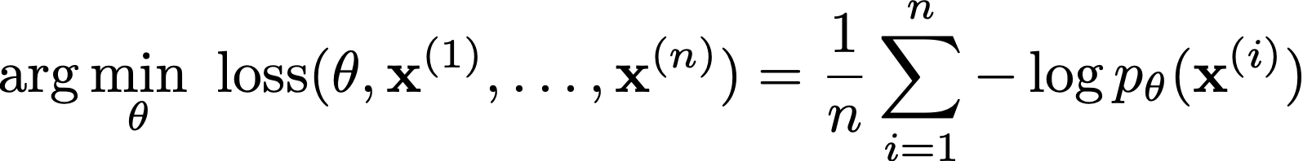
Maximum likelihood
Maximum likelihood: given a dataset x⁽¹⁾, …, x^{(n)}, find θ by solving the optimization problem
Statistics tells us that if the model family is expressive enough and if enough data is given, then solving the maximum likelihood problem will yield parameters that generate the data
Equivalent to minimizing KL divergence between the empirical data distribution and the model

Slide 10
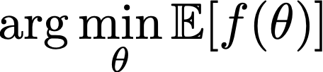
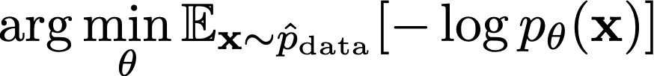
Stochastic gradient descent
Maximum likelihood is an optimization problem. How do we solve it?
Stochastic gradient descent (SGD).
SGD minimizes expectations: for f a differentiable function of θ, it solves
With maximum likelihood, the optimization problem is
Why maximum likelihood + SGD? It works with large datasets and is compatible with neural networks.

Slide 11
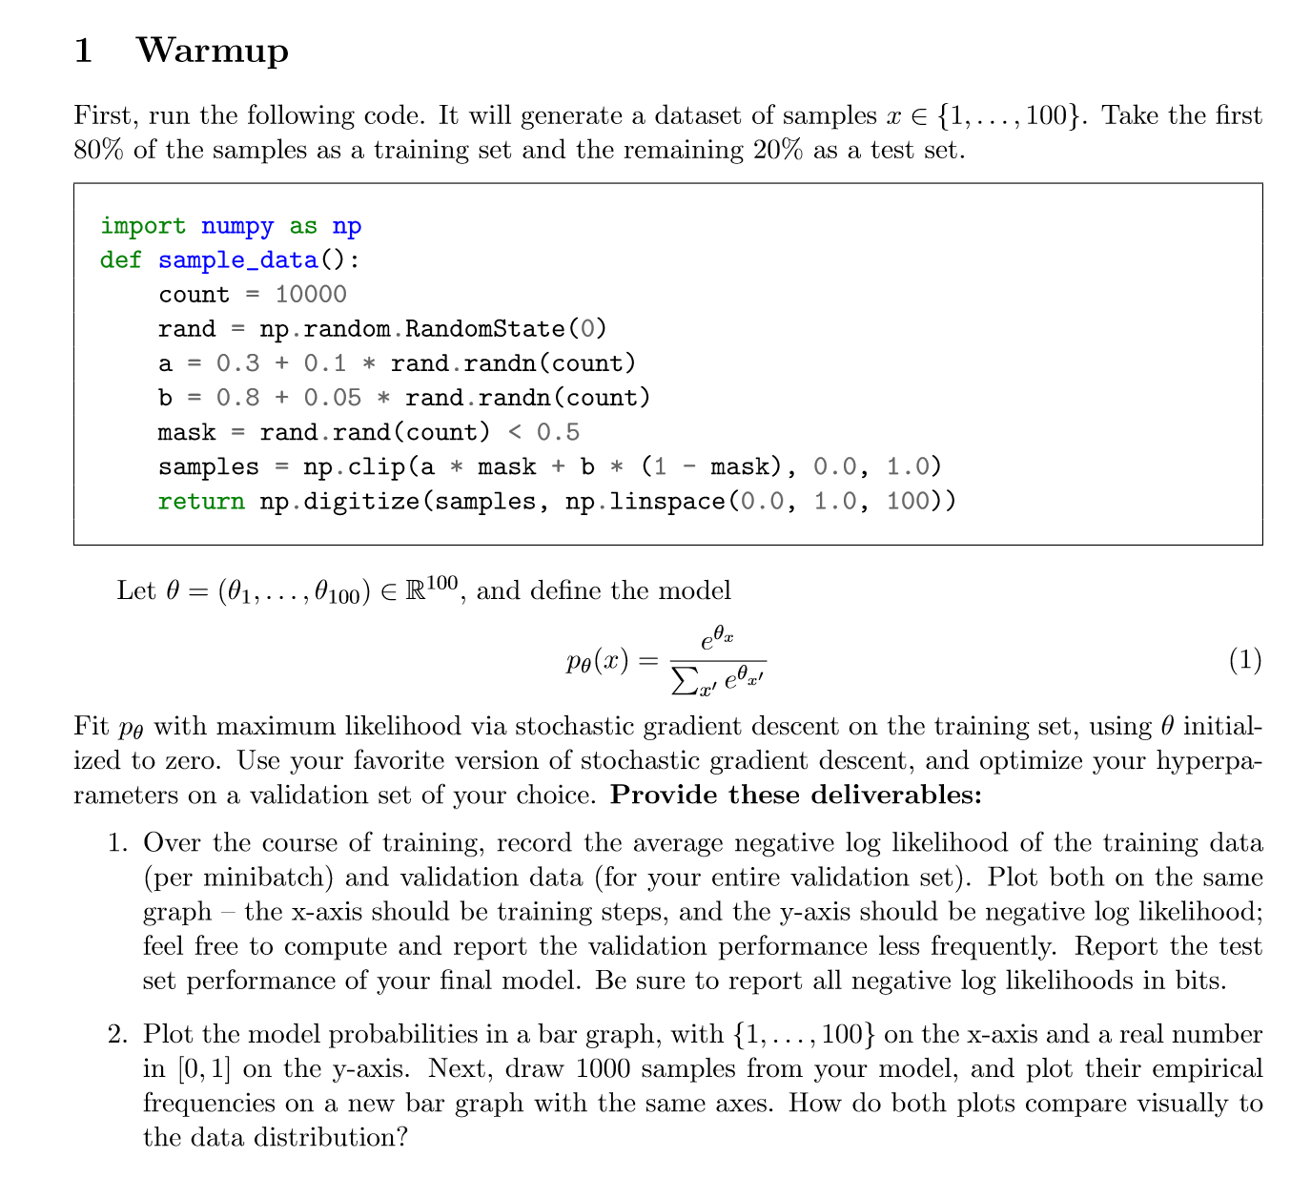
Homework 1

Slide 12
Designing the model
Key requirement for maximum likelihood + SGD: efficiently compute log p(x) and its gradient
We will choose models p_{θ} to be deep neural networks, which work in the regime
of high expressiveness and efficient computation (assuming specialized hardware)
How exactly do we design these networks?
- Any setting of θ must define a valid probability distribution over x:
log p_{θ}(x) should be easy to evaluate and differentiate with respect to θ
This can be tricky to set up!

Slide 13
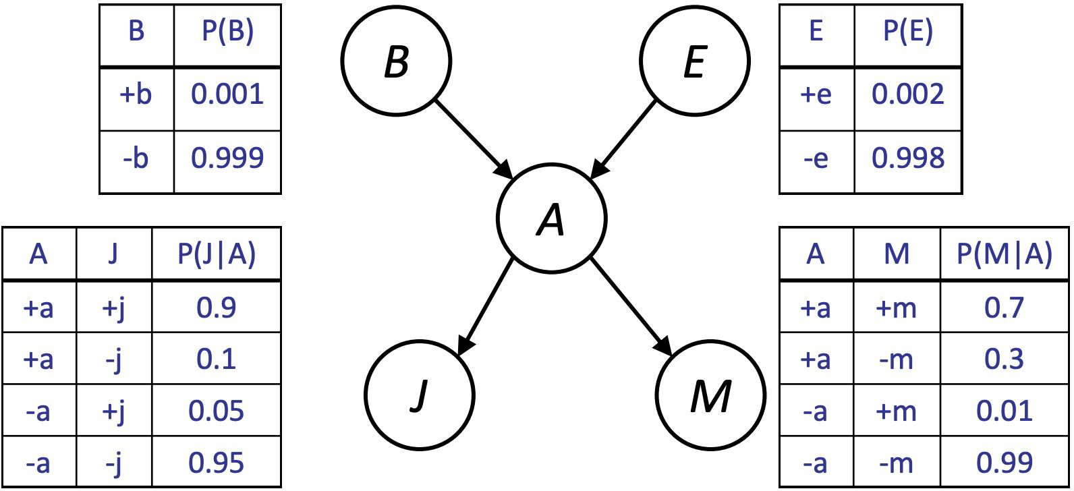
Bayes nets and neural nets
Main idea: place a Bayes net structure (a directed acyclic graph) over the variables in the data, and model the conditional distributions with neural networks.
Reduces the problem to designing co variables. We know how to do this: t as input, and outputs the distribution
nditional likelihood-based models for single
he neural net takes variables being conditioned on for the variable being predicted.

Slide 14
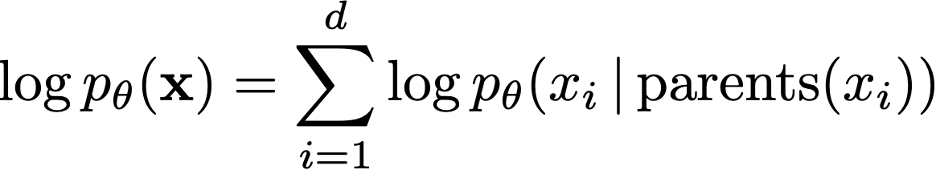
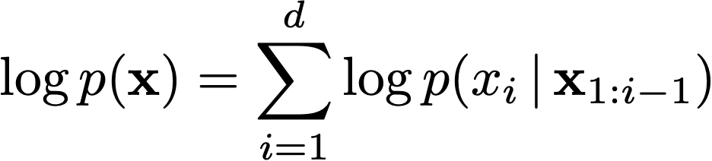
Autoregressive models
- First, given a Bayes net structure, setting the conditional distributions to neural networks will yield a tractable log likelihood and gradient. Great for maximum likelihood training!
- But is it expressive enough? Yes, assuming a fully expressive Bayes net structure: any joint distribution can be written as a product of conditionals
- This is called an autoregressive model. So, an expressive Bayes net structure with neural network conditional distributions yields an expressive model for p(x) with tractable maximum likelihood training.

Slide 15
A toy autoregressive model
Two variables: x₁, x₂
Model: p(x₁, x₂) = p(x₁) p(x₂|x₁)
p(x₁) is a histogram
p(x₂|x₁) is a multilayer perceptron
Input is x₁
Output is a distribution over x₂ (logits, followed by softmax)

Slide 16
One function approximator per conditional
Does this extend to high dimensions?
Somewhat. For d-dimensional data, O(d) parameters
Much better than O(exp(d)) in tabular case
What about text generation where d can be arbitrarily large?
Limited generalization
No information sharing among different conditionals
Solution: share parameters among conditional distributions. Two approaches:
Recurrent neural networks
Masking

Slide 17
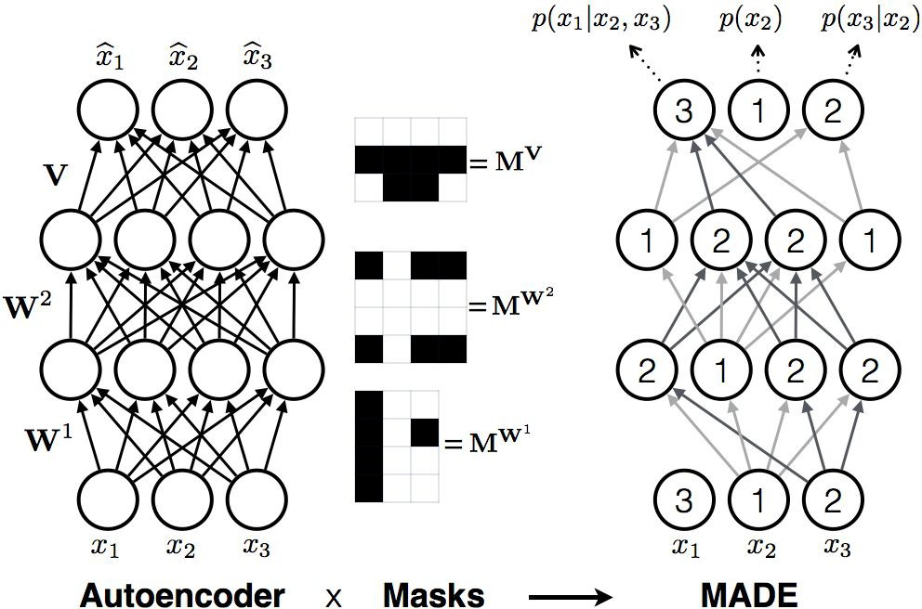
Masked Autoencoder for Distribution Estimation (MADE)

Slide 18
Masked Autoencoder for Distribution Estimation (MADE)
# param: normal FC weight # x: layer input
# y: autoregressive activations
mask = get_linear_ar_mask(in_size, out_size) # create mask of pattern
# | array([[0., | 1., | 1.],
# | [0., | 0., | 1.],
# | [0., | 0., | 0.]], dtype=float32)
y = tf.matmul(x, param * mask)

Slide 19
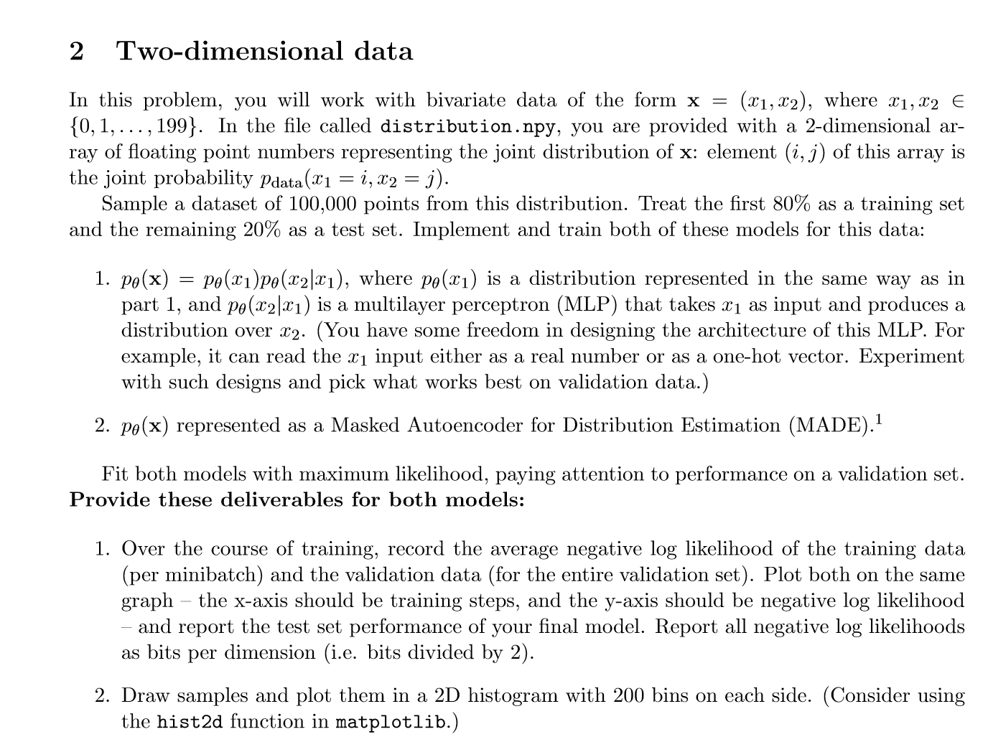
Homework 2

Slide 20
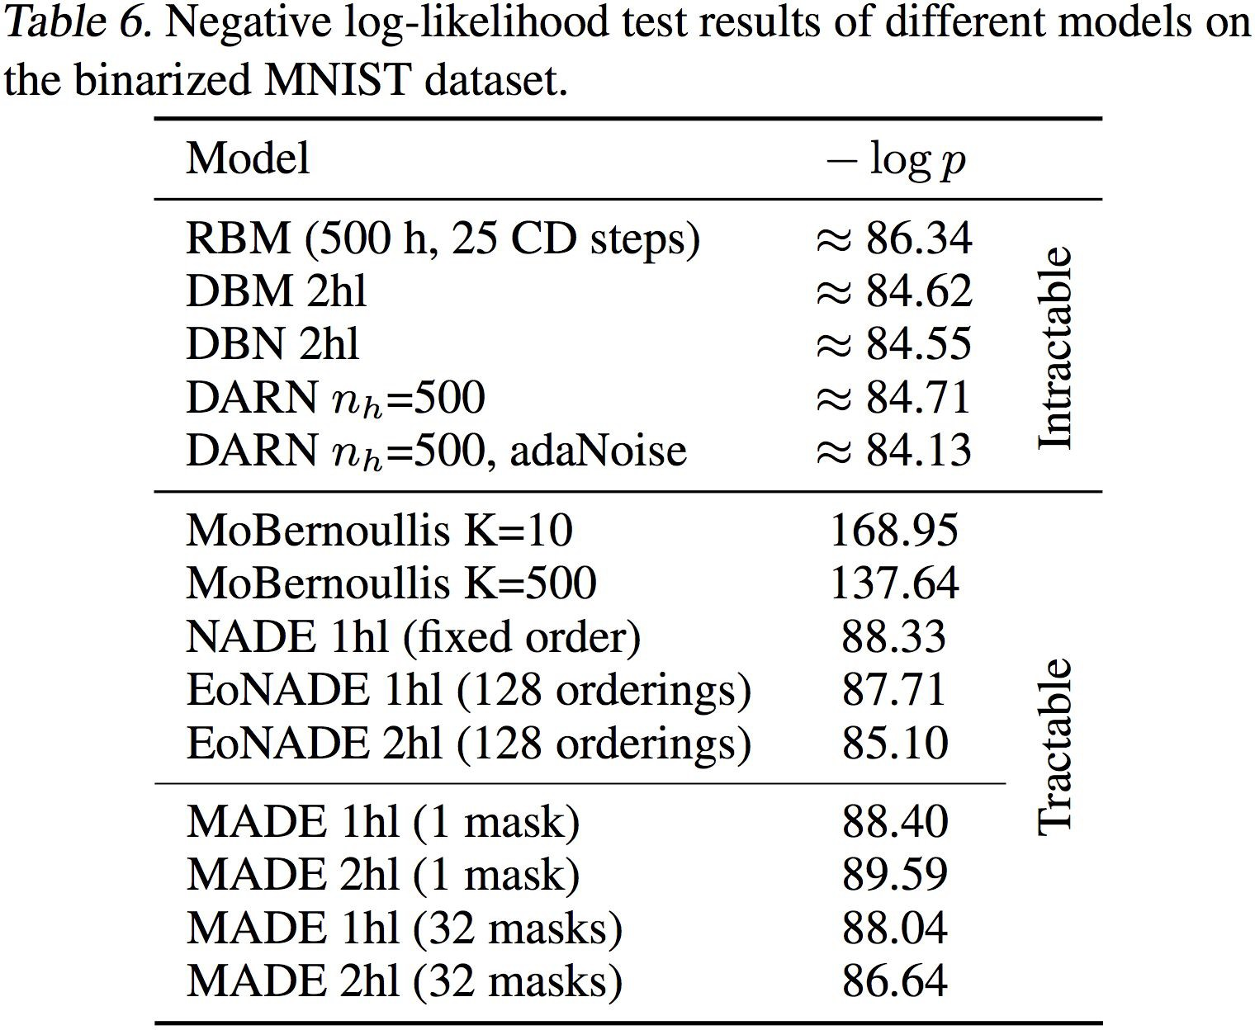
MADE results

Slide 21
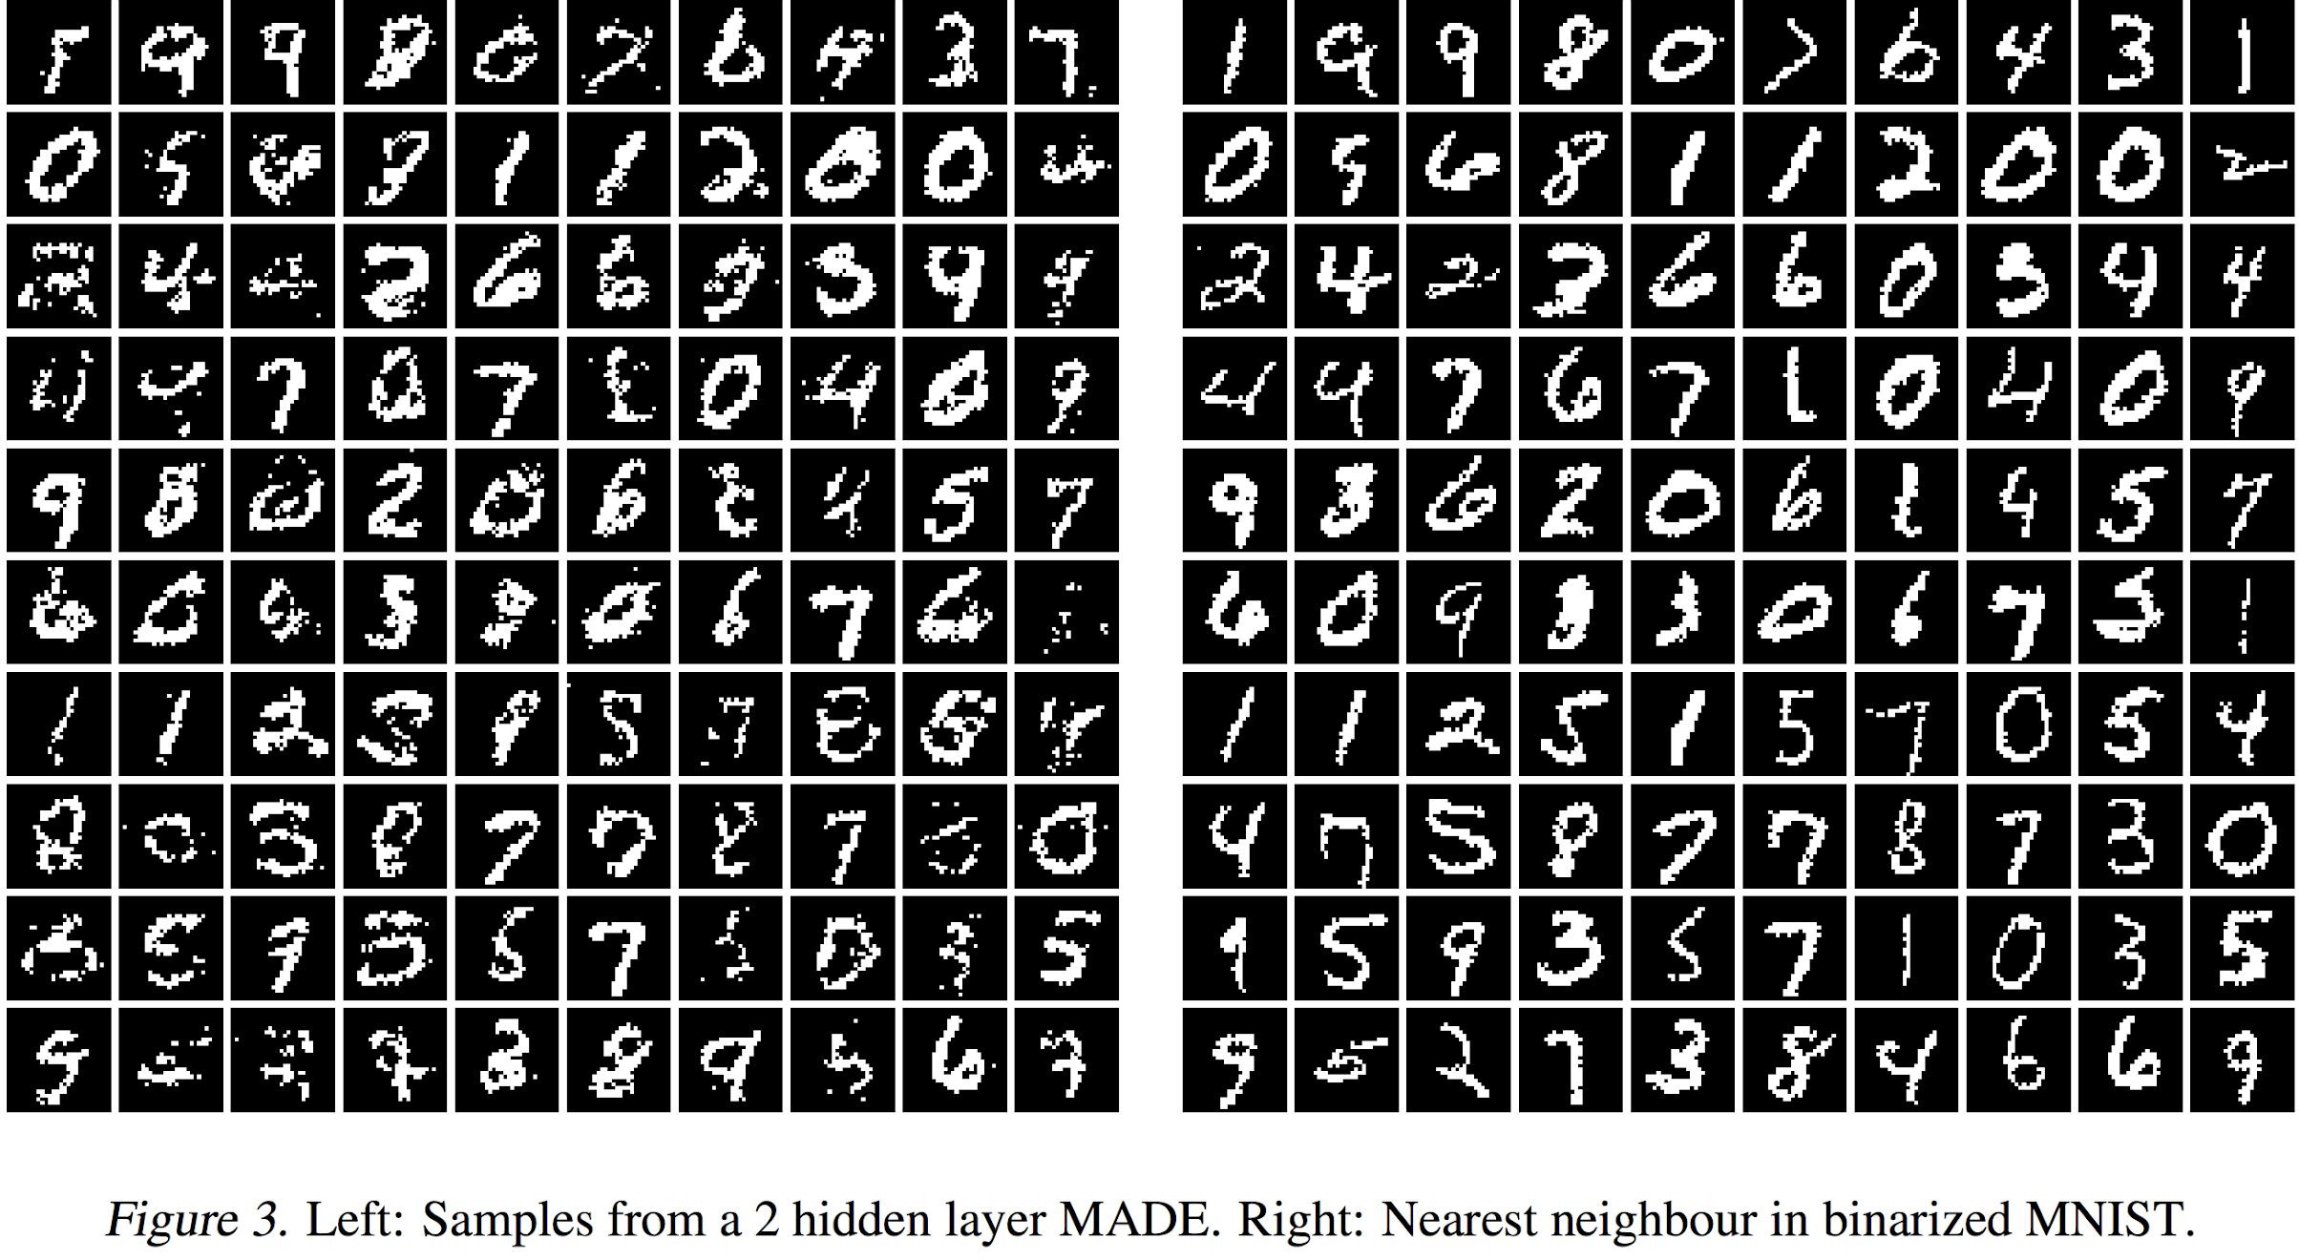
MADE results

Slide 22
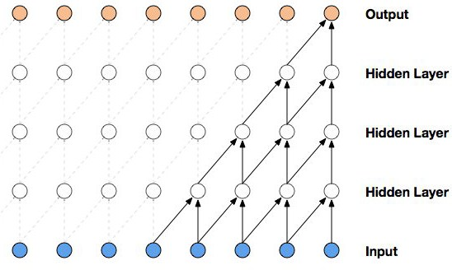
Masked Temporal (1D) Convolution
p(x_{i+1}| x_{<=i})
Easy to implement, masking part of the conv kernel
Constant parameter count for variable-length distribution!
Efficient to compute, convolution has hyper-optimized implementations on all hardware
However
Limited receptive field, linear in number of layers
x_{i}

Slide 23
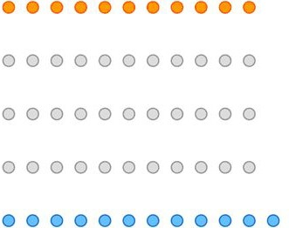
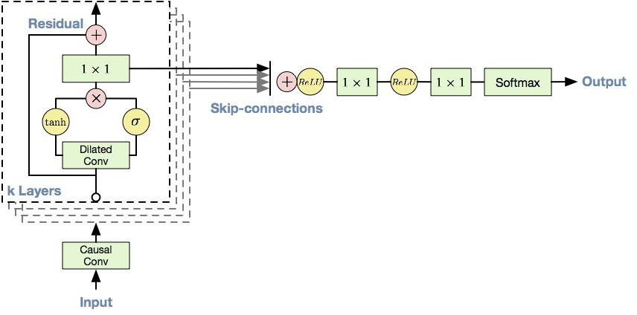
WaveNet
Improved receptive field: dilated convolution, with exponential dilation
Better expressivity: Gated Residual blocks, Skip connections

Slide 24
Masked Temporal (1D) Convolution
# More efficient implementation possible by # padding instead of masking kernels
# k: size of kernel
# kernel: convolution weights padded_x = tf.pad(x, [
(0, 0), (k - 1, 0),
(0, 0), (0, 0)
])
y = tf.nn.conv2d(padded_x, kernel, padding='VALID')

Slide 25
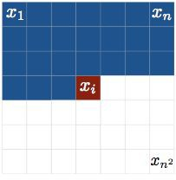
Masked Spatial (2D) Convolution - PixelCNN
Images can be flatten into 1D vectors, but they are fundamentally 2D
We can use a masked variant of ConvNet to exploit this knowledge
First, we impose an autoregressive ordering on 2D images:
This is called raster scan ordering. (Different orderings are possible, more on this later)

Slide 26
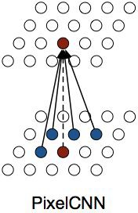
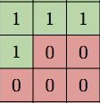
PixelCNN
Design question: how to design a masking method to obey that ordering?
One possibility: PixelCNN (2016)

Slide 27
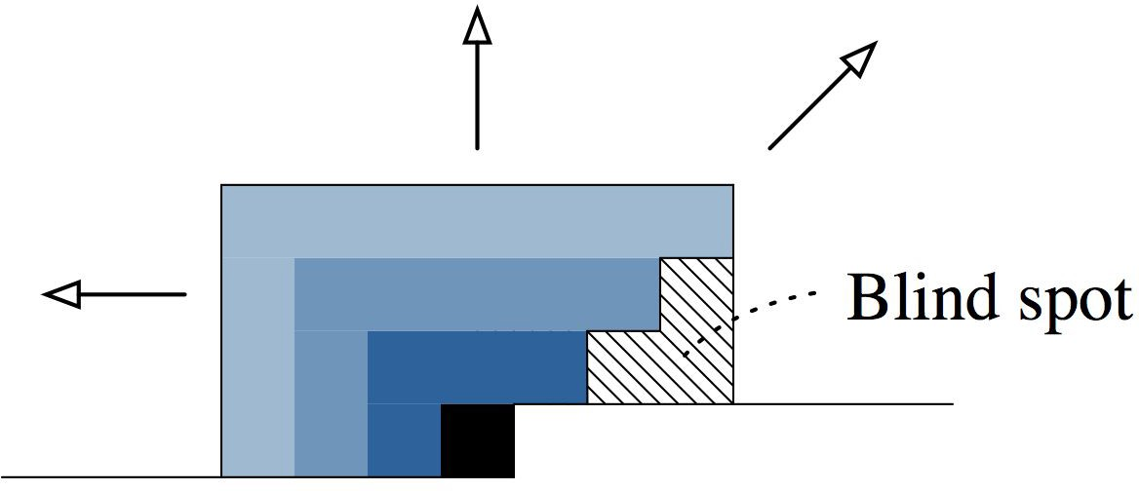
PixelCNN
PixelCNN-style masking has one problem: blind spot in receptive field

Slide 28
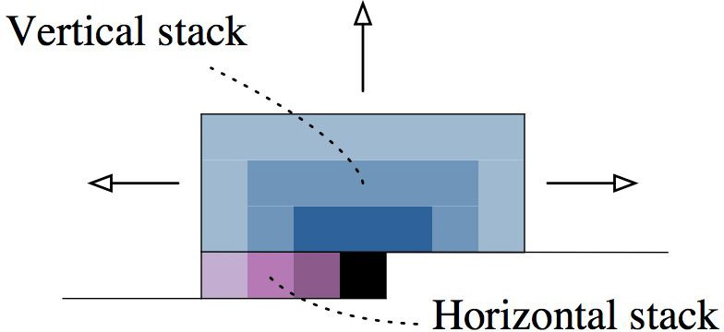
Gated PixelCNN
Gated PixelCNN (2016) introduced a fix by combining two streams of convolutions
How?
This is easy, we know how to do 1D masked conv

Slide 29
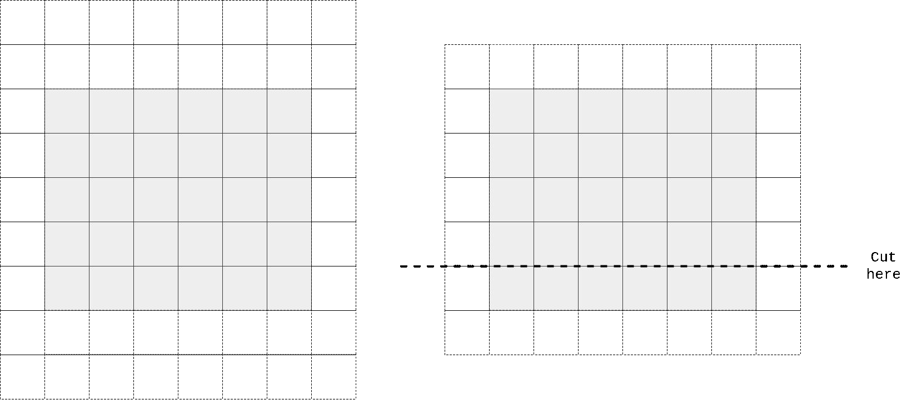
Gated PixelCNN
Vertical stack: through padding, activations at ith row only depend on input before ith row

Slide 30
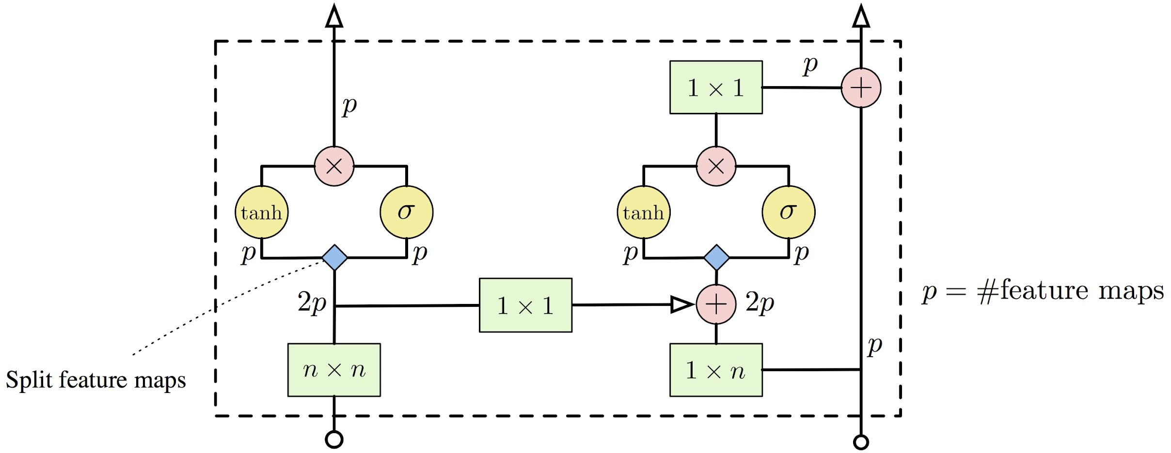
Gated PixelCNN
Improved ConvNet architecture: Gated ResNet Block

Slide 31
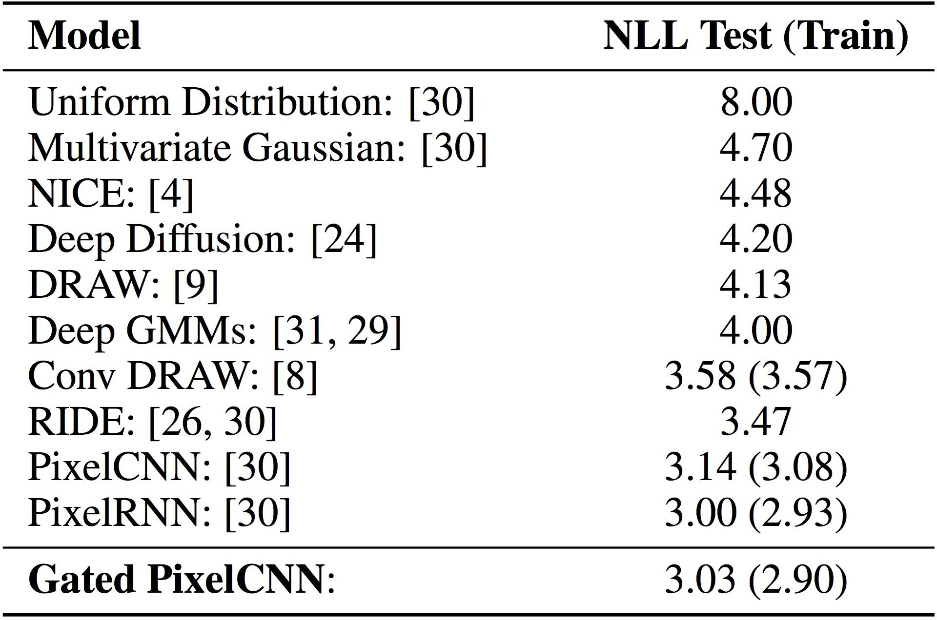
Gated PixelCNN
Better receptive field + more expressive architecture = better performance

Slide 32
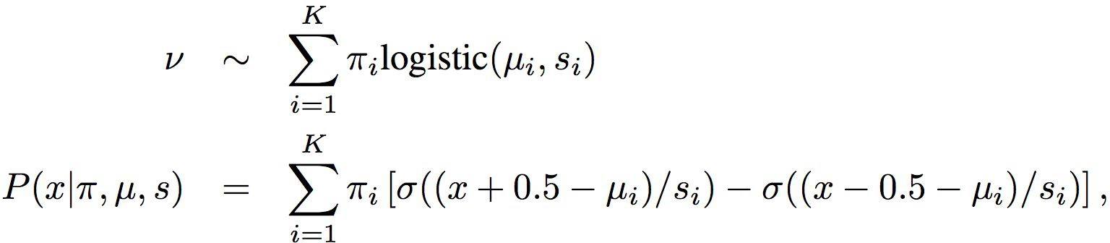
PixelCNN++
Moving away from softmax: we know nearby pixel values are likely to co-occur!

Slide 33
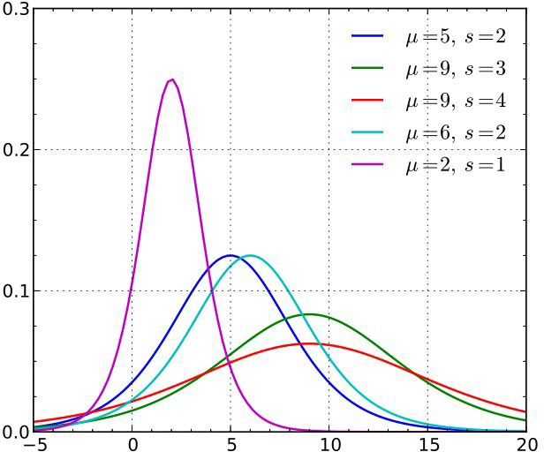
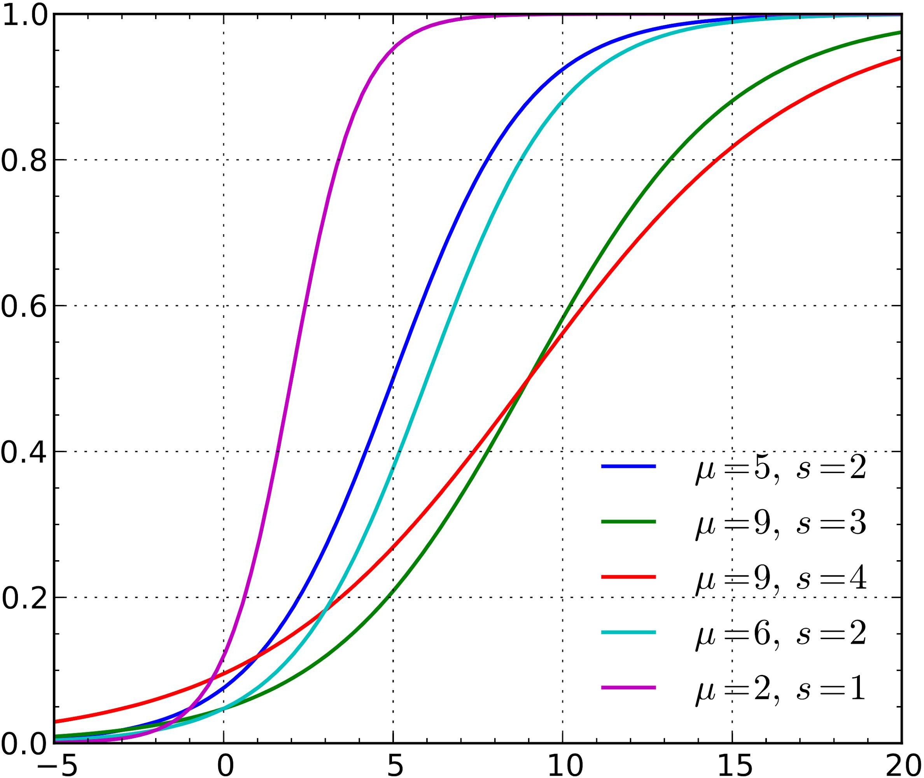
Recap: Logistic distribution
pdf
cdf
= sigmoid((x - mu) / scale)

Slide 34
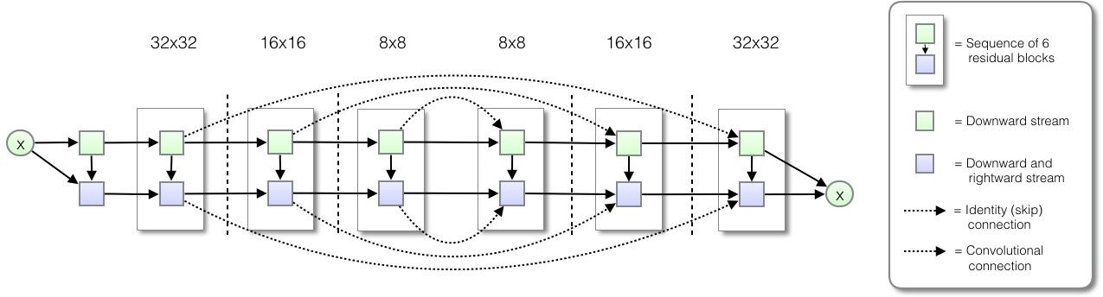
PixelCNN++
Capture long dependencies efficiently by downsampling

Slide 35
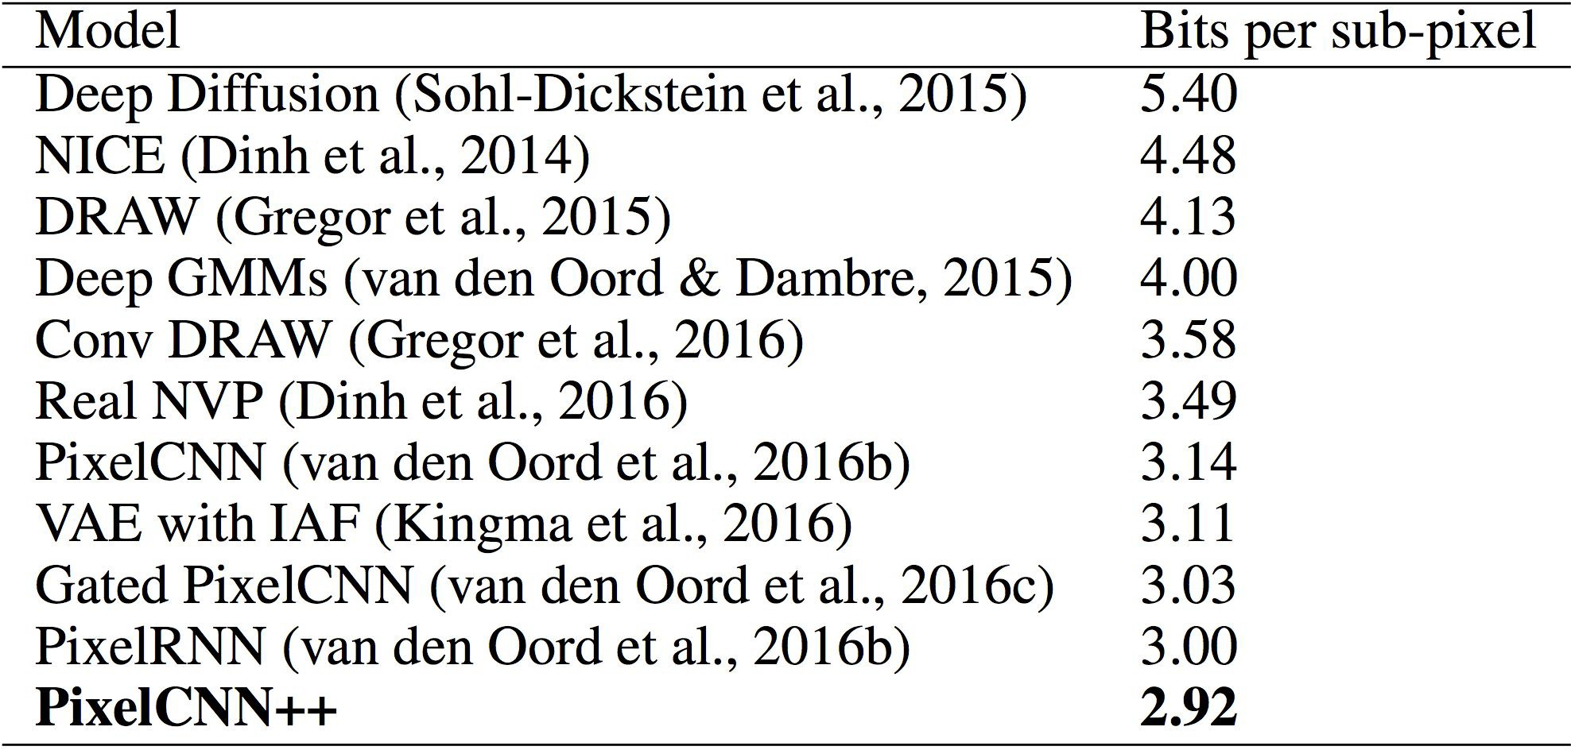
PixelCNN++

Slide 36
Masked Attention
A recurring problem for convolution: limited receptive field -> hard to capture long-range dependencies
(Self-)Attention: an alternative that has
unlimited receptive field!!
also O(1) parameter scaling w.r.t. data dimension
parallelized computation (versus RNN)

Slide 37
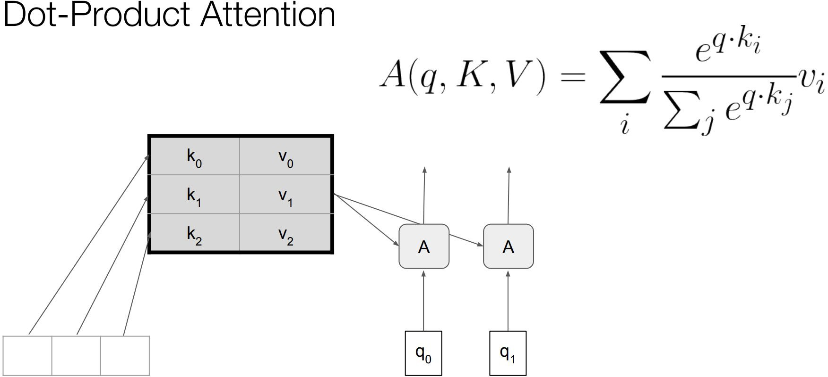
Attention
Self-attention when q_{i} also generated from x

Slide 38
Self-Attention
Convolution
Self-attention

Slide 39
Masked Attention
10
- masked(k_{i}, q) * 10
- masked(k , q) * 10¹⁰
i

Slide 40
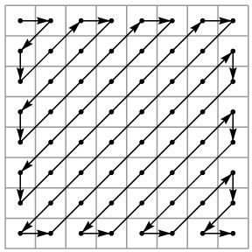
Masked Attention
Much more flexible than masked convolution. We can design any autoregressive ordering we want
An example:
Zigzag ordering
How to implement with masked conv?
Trivial to do with masked attention!

Slide 41
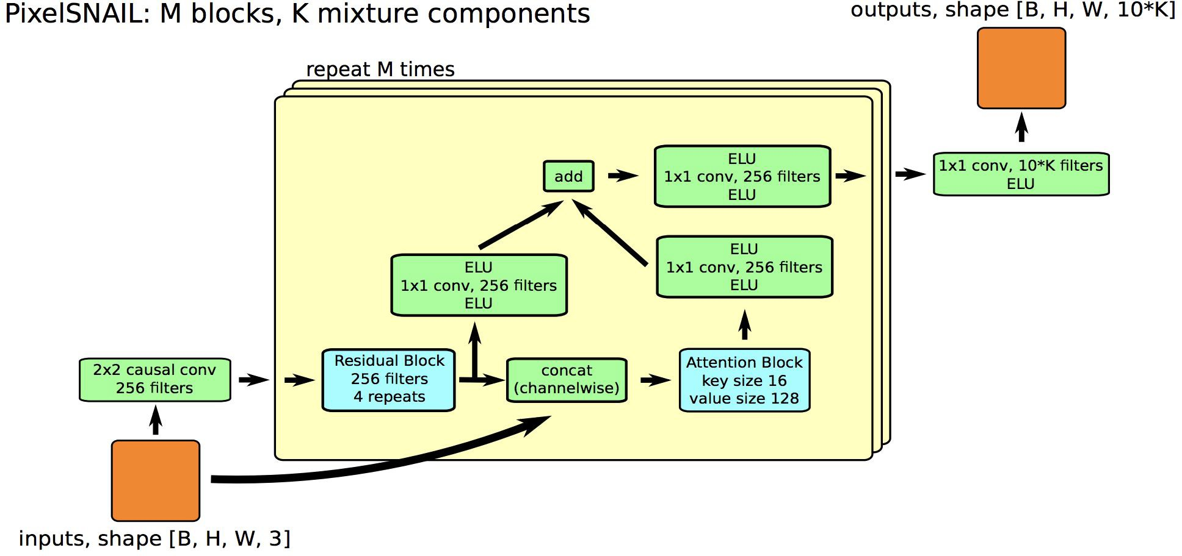
Masked Attention + Convolution

Slide 42
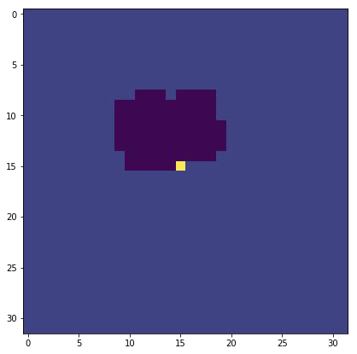
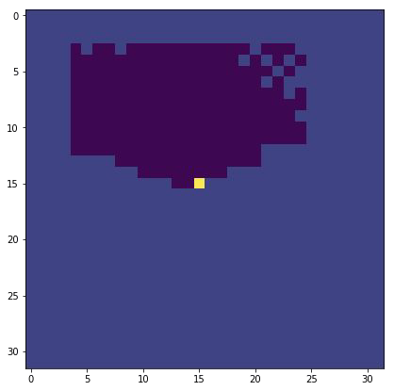
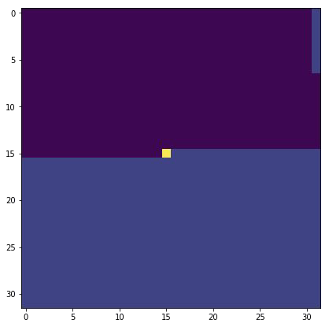
Masked Attention + Convolution
Gated PixelCNN
PixelCNN++
PixelSNAIL

Slide 43
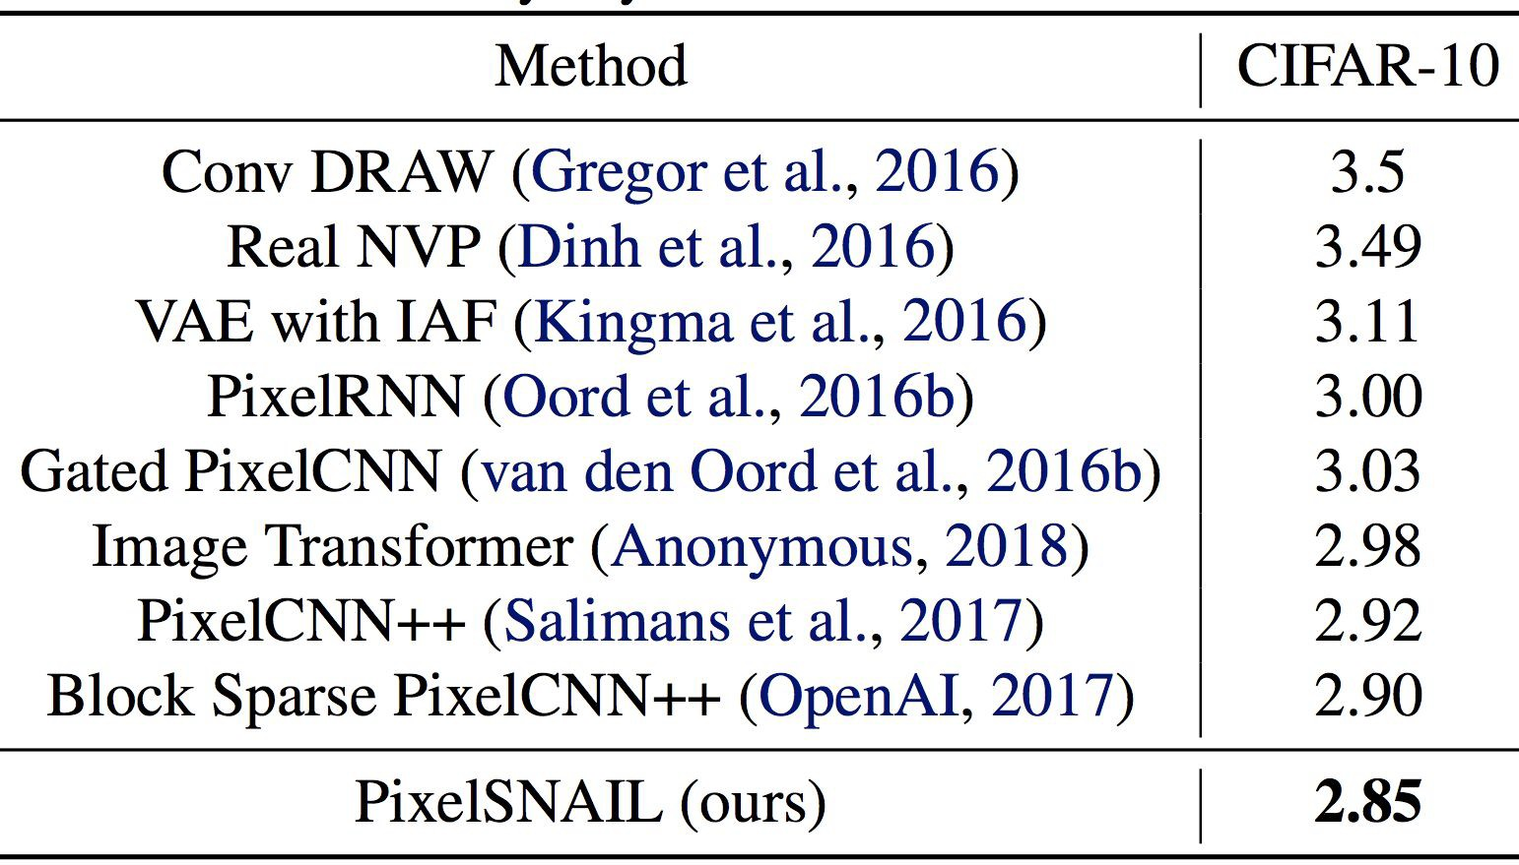
Masked Attention + Convolution

Slide 44
Neural autoregressive models: the good
Best in class modelling performance:
expressivity - autoregressive factorization is general
generalization - meaningful parameter sharing has good inductive bias
-> State of the art models on multiple datasets, modalities

Slide 45
Masked autoregressive models: the bad
Sampling each pixel = 1 forward pass!
11 minutes to generate 16 32-by-32 images on a Tesla K40 GPU

Slide 46
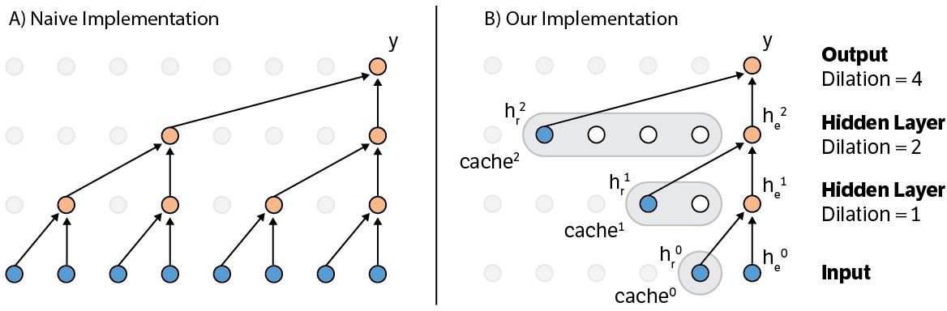
Speedup by caching activations
https://github.com/PrajitR/fast-pixel-cnn

Slide 47
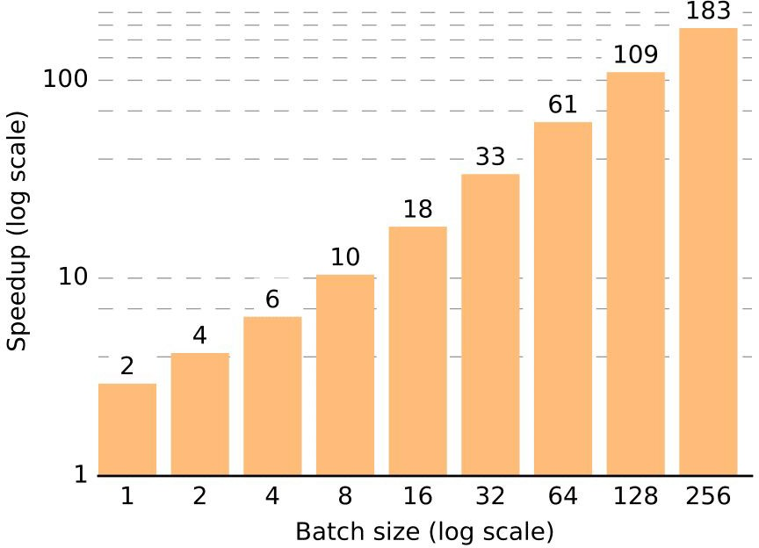
Speedup by caching activations
https://github.com/PrajitR/fast-pixel-cnn

Slide 48
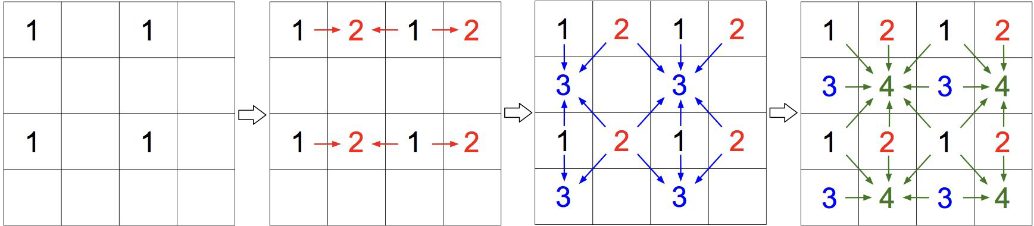
Speedup by breaking autoregressive pattern
O(d) -> O(log(d)) by parallelizing within groups {2, 3, 4}
Cannot capture dependencies within each group: this is a fine assumption if all pixels in one group are conditionally independent
Most often they are not, then you trade expressivity for sampling speed

Slide 49
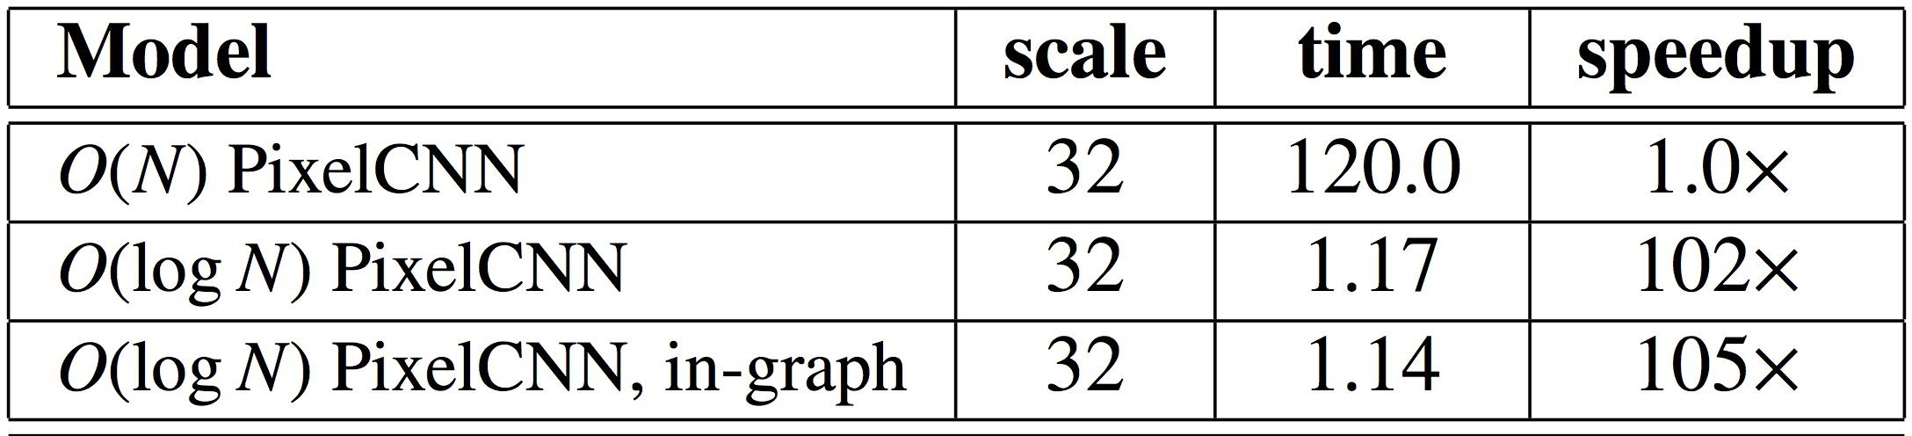
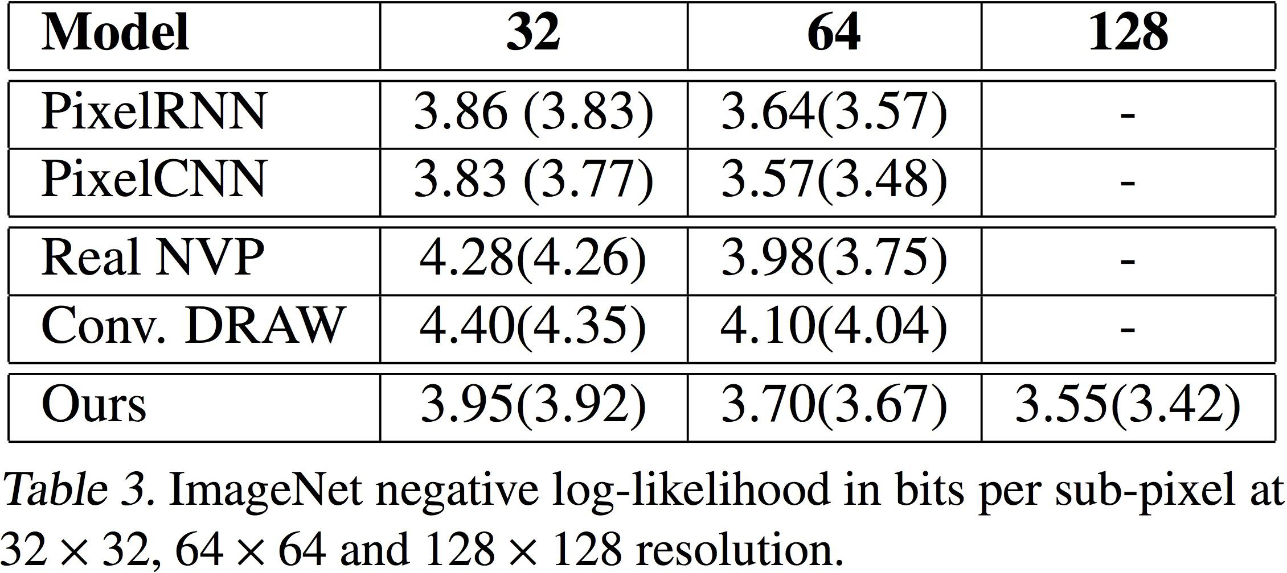
Multiscale PixelCNN
Improved sampling speed
More limited modelling capacity

Slide 50
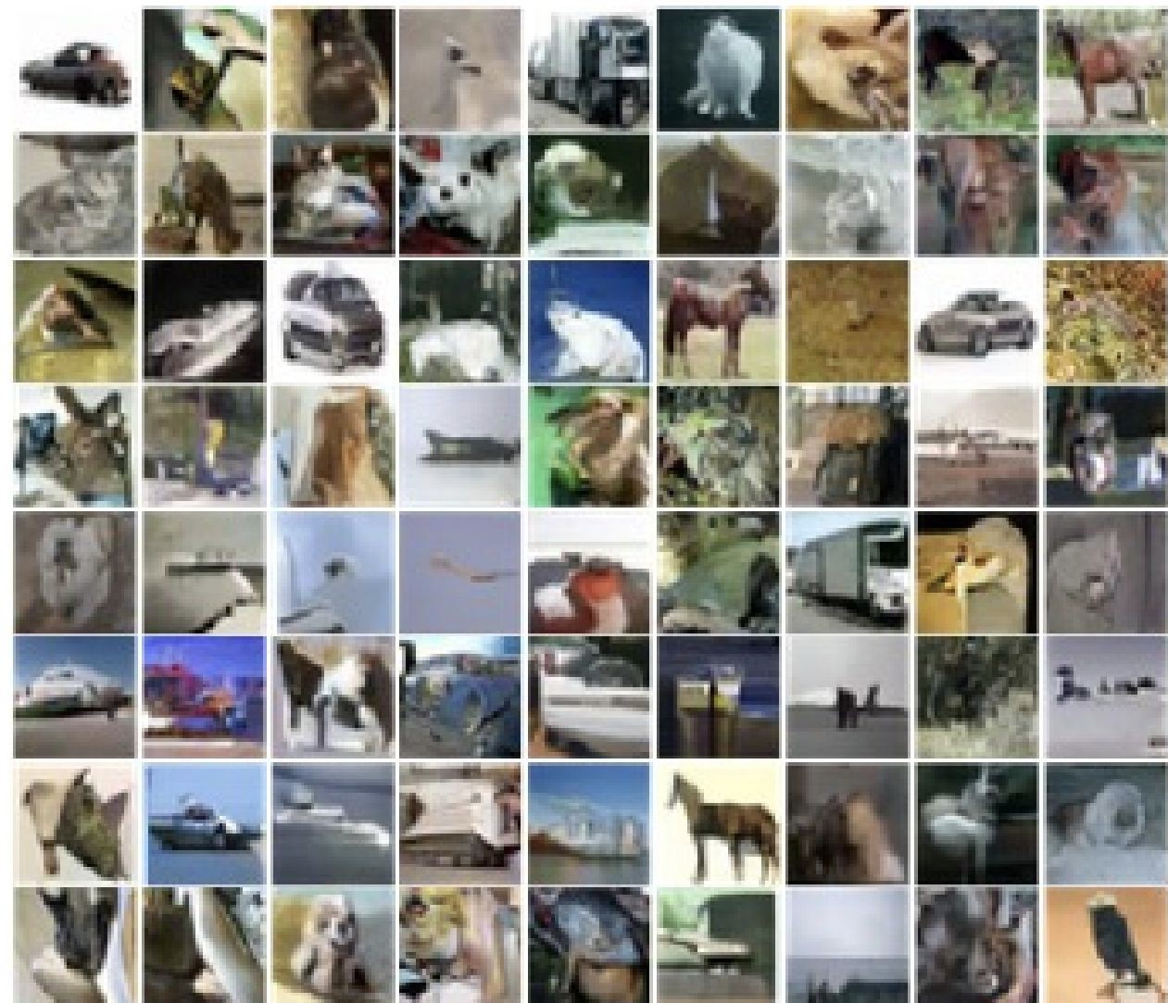
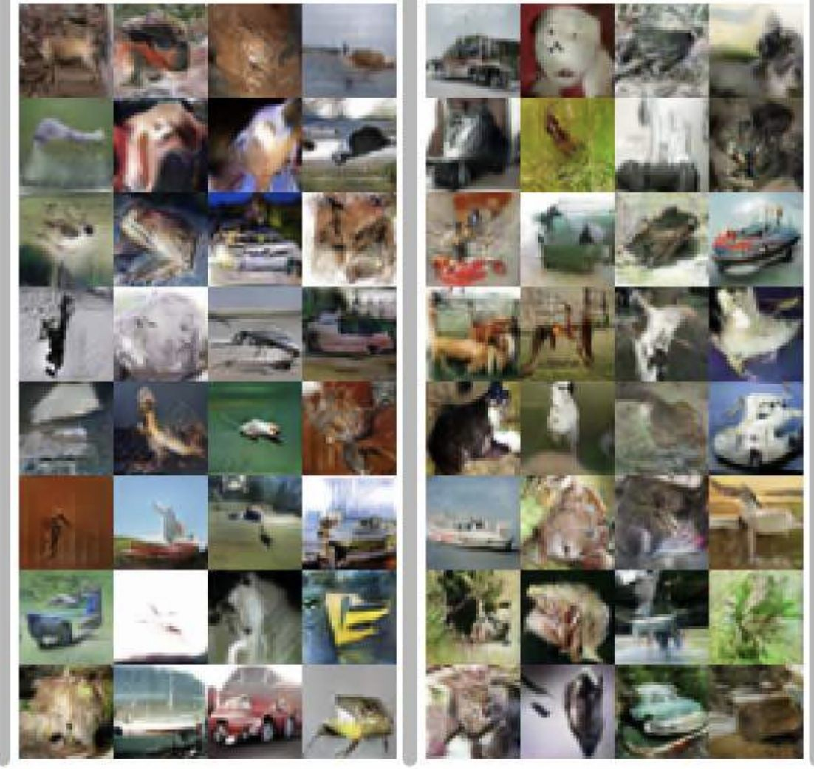
Sample Quality
Which set of samples are generated by a GAN versus an AR model?

Slide 51
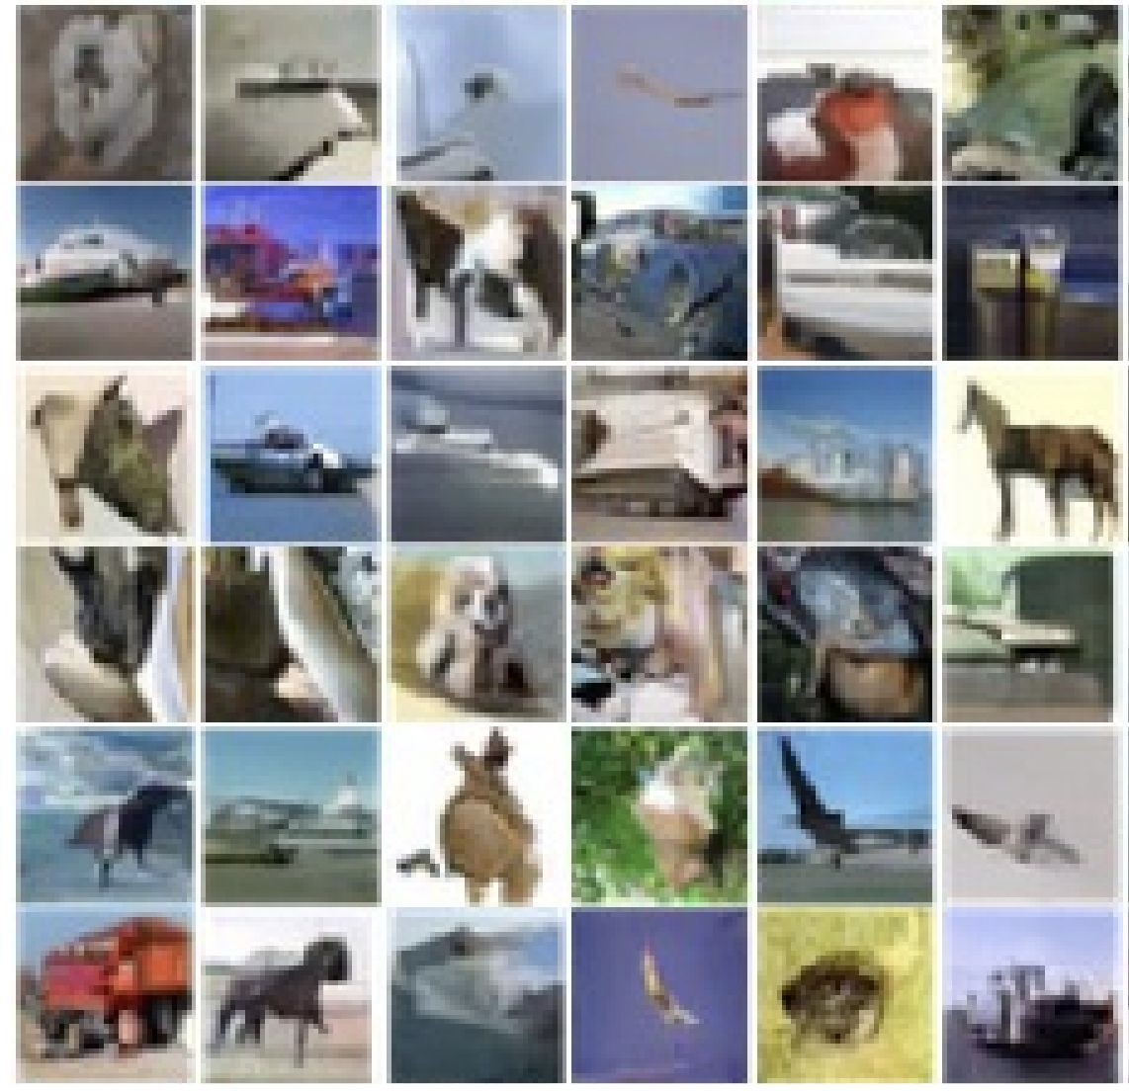
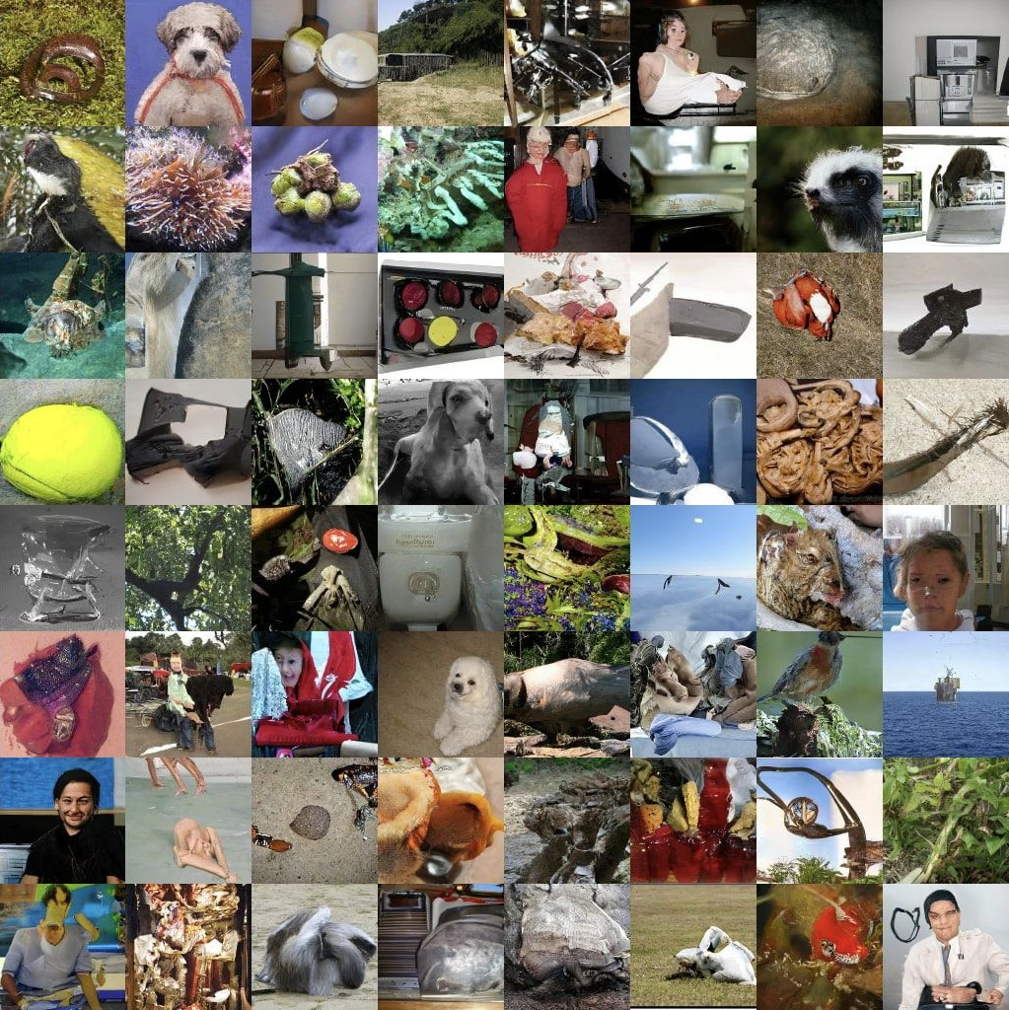
AR models can have good samples
Good samples can be achieved by selective bits conditioning
Grayscale PixelCNN
Subscale Pixel Network

Slide 52
Bibliography
char-rnn: http://karpathy.github.io/2015/05/21/rnn-effectiveness/
MADE: Germain, Mathieu, et al. "Made: Masked autoencoder for distribution estimation." International Conference on Machine Learning. 2015. WaveNet: Oord, Aaron van den, et al. "Wavenet: A generative model for raw audio." arXiv preprint arXiv:1609.03499 (2016).
PixelCNN: Oord, Aaron van den, Nal Kalchbrenner, and Koray Kavukcuoglu. "Pixel recurrent neural networks." arXiv preprint arXiv:1601.06759
(2016).
Gated PixelCNN: Van den Oord, Aaron, et al. "Conditional image generation with pixelcnn decoders." Advances in Neural Information Processing Systems. 2016.
PixelCNN++: Salimans, Tim, et al. "Pixelcnn++: Improving the pixelcnn with discretized logistic mixture likelihood and other modifications." arXiv preprint arXiv:1701.05517 (2017)
Self-attention: Vaswani, Ashish, et al. "Attention is all you need." Advances in Neural Information Processing Systems. 2017. PixelSNAIL: Chen, Xi, et al. "Pixelsnail: An improved autoregressive generative model." arXiv preprint arXiv:1712.09763 (2017)
Fast PixelCNN++: Ramachandran, Prajit, et al. "Fast generation for convolutional autoregressive models." arXiv preprint arXiv:1704.06001(2017).
Multiscale PixelCNN: Reed, Scott, et al. "Parallel multiscale autoregressive density estimation." Proceedings of the 34th International Conference on Machine Learning-Volume 70. JMLR. org, 2017.
Grayscale PixelCNN: Kolesnikov, Alexander, and Christoph H. Lampert. "PixelCNN models with auxiliary variables for natural image modeling."
Proceedings of the 34th International Conference on Machine Learning-Volume 70. JMLR. org, 2017.
Subscale Pixel Network: Menick, Jacob, and Nal Kalchbrenner. "Generating High Fidelity Images with Subscale Pixel Networks and Multidimensional Upscaling." arXiv preprint arXiv:1812.01608(2018)

